Slide 1

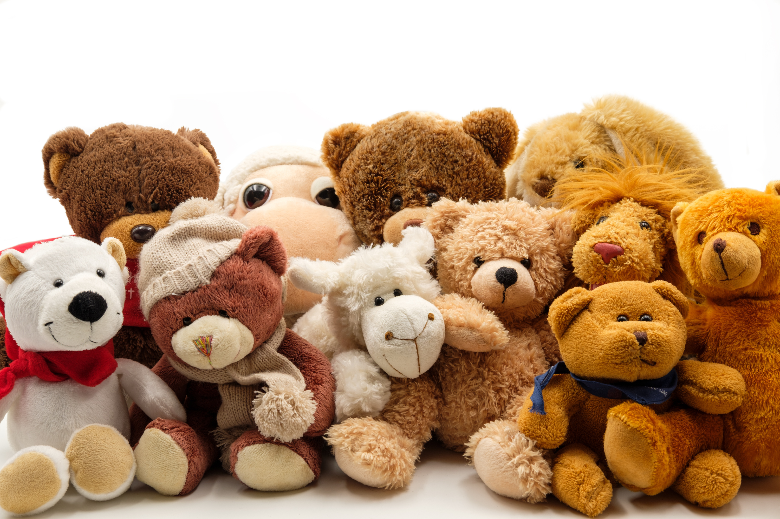

MAVEN FUZZY
BUSINESS ANALYSIS

Slide 2
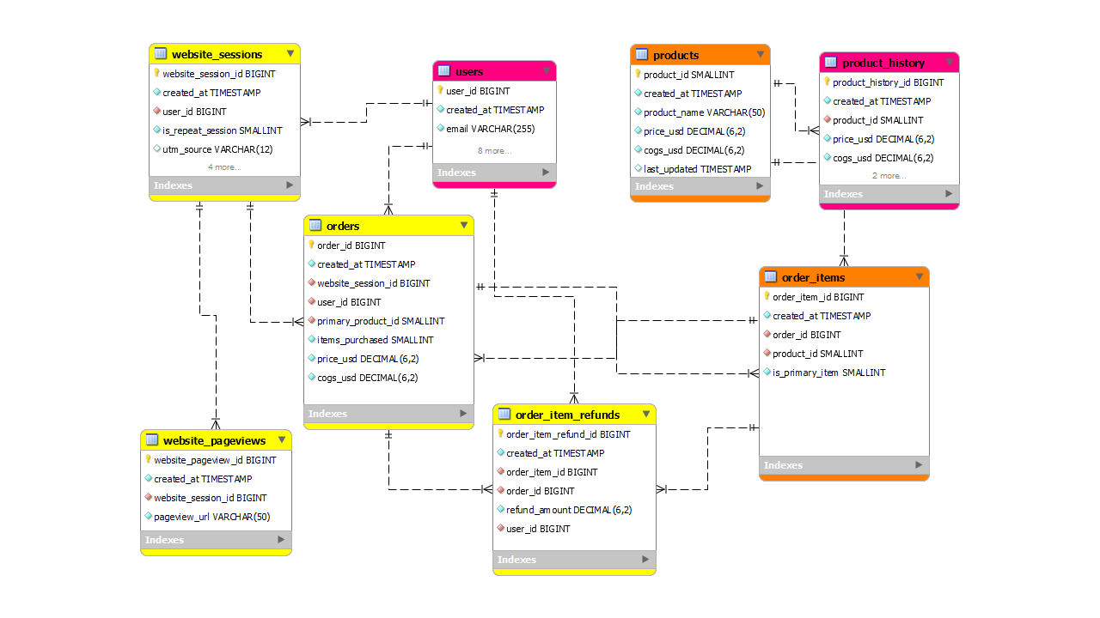
METADATA

Slide 3

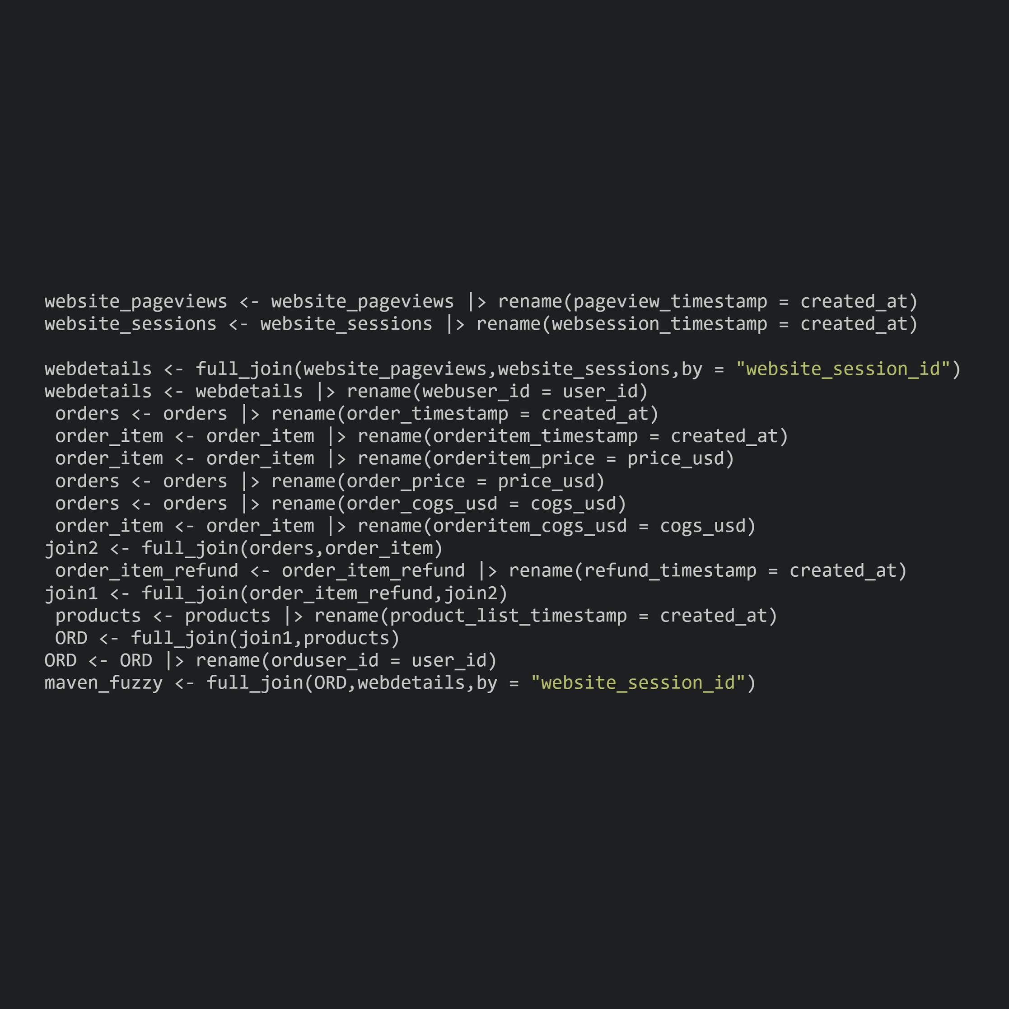
DATA PROCESSING
JOINS AND RENAMING
website_pageviews <- website_pageviews |> rename(pageview_timestamp = created_at)
website_sessions <- website_sessions |> rename(websession_timestamp = created_at)
webdetails <- full_join(website_pageviews,website_sessions,by = "website_session_id")
webdetails <- webdetails |> rename(webuser_id = user_id)
orders <- orders |> rename(order_timestamp = created_at)
order_item <- order_item |> rename(orderitem_timestamp = created_at)
order_item <- order_item |> rename(orderitem_price = price_usd)
orders <- orders |> rename(order_price = price_usd)
orders <- orders |> rename(order_cogs_usd = cogs_usd)
order_item <- order_item |> rename(orderitem_cogs_usd = cogs_usd)
join2 <- full_join(orders,order_item)
order_item_refund <- order_item_refund |> rename(refund_timestamp = created_at)
join1 <- full_join(order_item_refund,join2)
products <- products |> rename(product_list_timestamp = created_at)
ORD <- full_join(join1,products)
ORD <- ORD |> rename(orduser_id = user_id)
maven_fuzzy <- full_join(ORD,webdetails,by = "website_session_id")

Slide 4

BUSINESS GROWTH ANALYSIS
ANALYZING BUSINESS GROWTH BY PROFITS YEAR BY YEAR AND QUARTERLY
ANALYZING BUSINESS GROWTH BY USERS YEAR BY YEAR AND QUARTERLY
DETERMINING PROFT GAP EFFECT CAUSED TO PROFITS BY REFUNDS
DETERMING AVETRAGE ORDER PRICE YEAR BY YEAR AND QUARTERLY

Slide 5
REFUNDS ANALYSIS
REFUND TRIGGER ON ORDERS FOR EACH QUARTER
ANALYZING REFUND PERCENTAGE YEAR BY YEAR
ANALYZING AVERAGE REFUND PERCENTAGE IN EACH QUARTER
DETERMING AVERAGE REFUND CLAIM DURATION

Slide 6
PRODUCT ANALYSIS
PRODUCTS WITH MOST REFUND PERCENT
PRODUCTS WITH MOST CUSTOMER RETENTION
REPEAT ORDER BY CUSTOMERS PERCENTAGE
MOST BASKET PRODUCT FOR EACH ITEM AND MULTIPLE PRODUCTS PER ORDER PERCENTAGE
FREQUENT SHOPPING HOUR OF EACH PRODUCT
BOUNCE PERCENTAGE FOR EACH PRODUCT

Slide 7
WEB ANALYSIS
CUSTOMERS PROPORTION BY DEVICE USED
BOUNCE RATE OF WEB SESSIONS
CONVERSION RATE FOR MAIN PAGES
ENGAGEMENTS MADE BY EACH CONTENT
PERFORMANCE OF SOURCE AND CAMPAIGNS
DETERMINING AVERAGE WEBSESSION DURATION

Slide 8
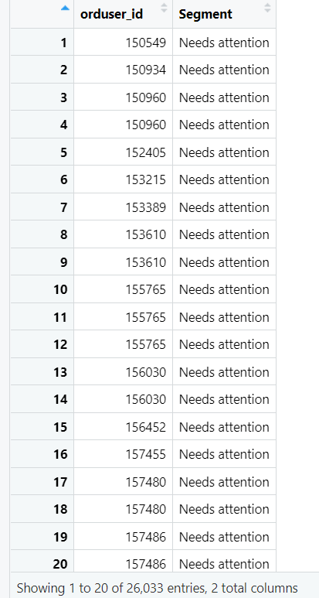
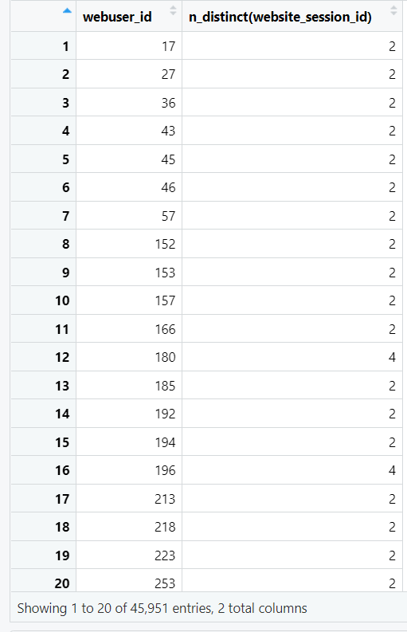

CUSTOMERS TO TARGET
CUSTOMERS WITH RFM
SEGMENTS OF
Champions
Good Customers
Needs attention
CUSTOMERS WITH MULTIPLE VISITS TO WEBSITE BUT NO ORDER HISTORY

